Slide 1
Travel Insurance Predictions
By: Alicia Lizarraga

Slide 2
DataSet Info
Source: https://www.kaggle.com/mhdzahier/travel-insurance/version/1
Description: Based in Singapore, a third-party travel insurance servicing company
Objective: To predict whether or not clients have filed for travel insurance claim (yes or no)

Slide 3
Data Cleaning

Slide 4
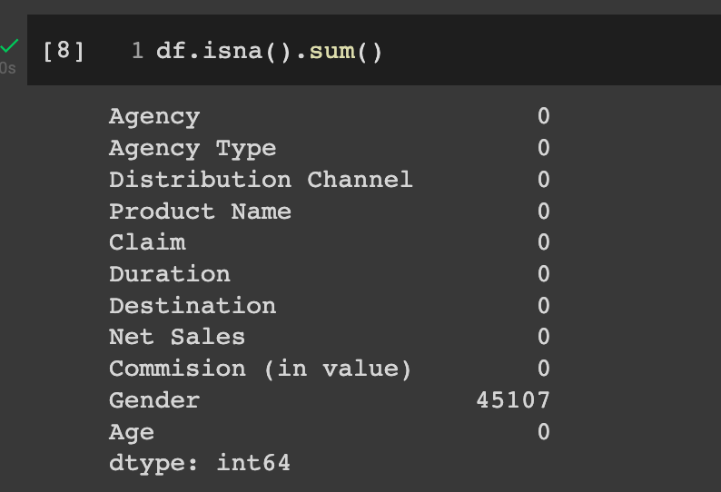

First Glances
Big chunk of data in ‘Gender’ column was missing
Took into consideration that this information for clients who were filing could have been optional to give up
Dropped column
A lot of duplicates
Dropped
Took a for loop and looked into all columns with object as dtype
Didn’t see anything that popped out as concerning

Slide 5
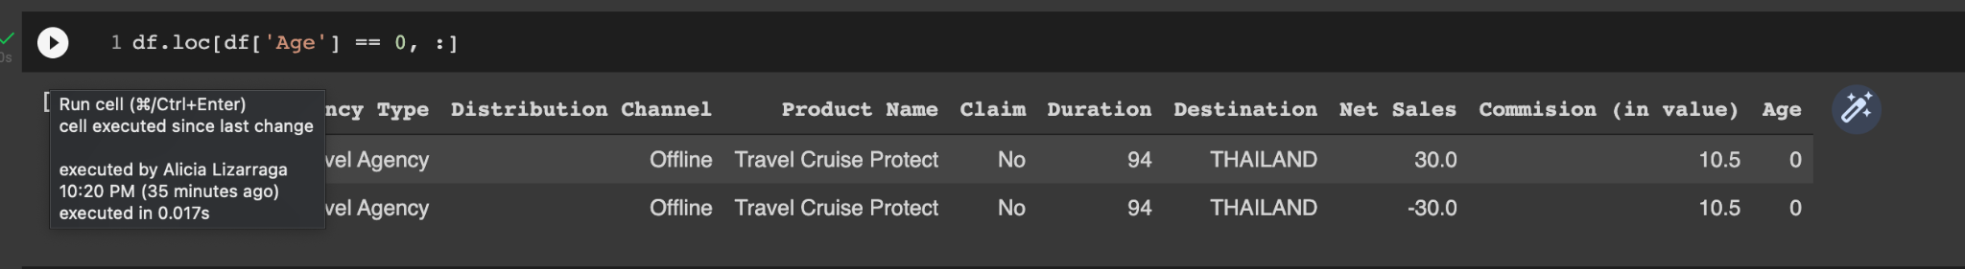
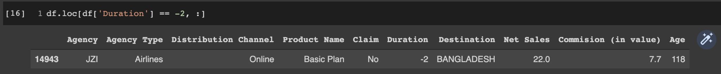
Numerical columns
Using df.describe I realized the values for min were equal to 0 for ‘Age’, so dropped these rows as an Age of zero doesn’t make sense
Also dropped the row for ‘Duration’ since the Age did not make sense

Slide 6
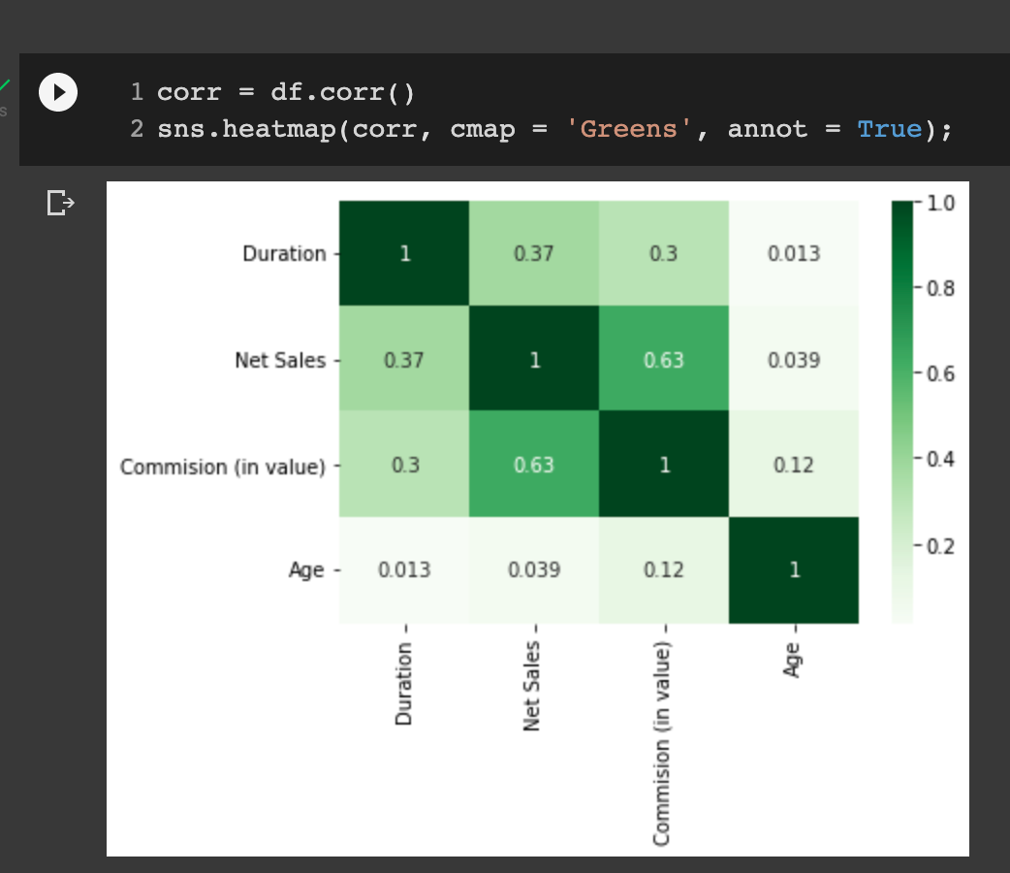
Exploratory Data Analysis

Slide 7
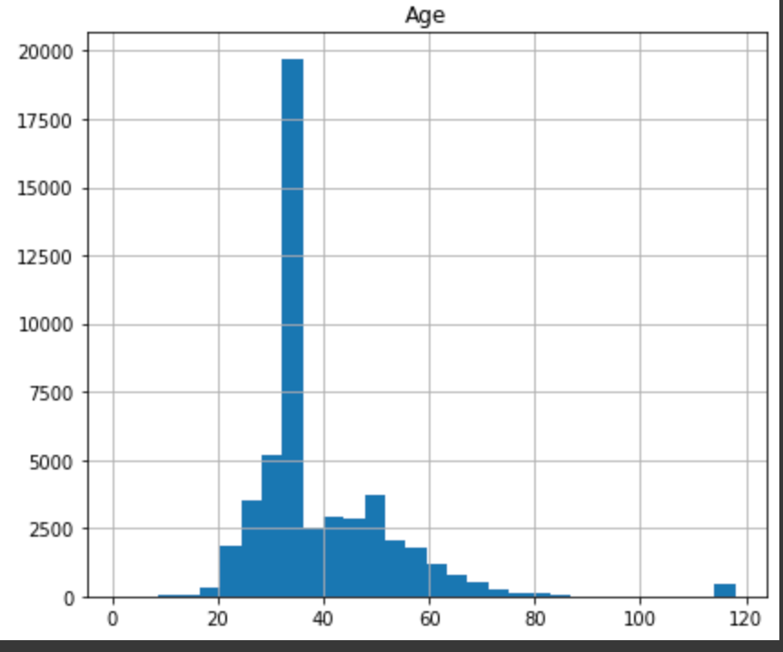
Exploratory Data Analysis(cont.)

Slide 8
Challenges
Trouble deciding whether or not to drop certain rows and columns

